Slide 1
PYTHON PROJECT
CAB BOOKING SYSTEM
Submitted to Ms Gagandeep Kaur

Slide 2
SUBMITTED BY:
1.Rishika Singh(11904961)
2.Abhijeet Kumar(11905729)
3.Prakhar Srivastava(11904878)

Slide 3
CONTENT
INTRODUCTION
OBJECTIVE
DESCRIPTION OF THE PROJECT
ABOUT THE PROJECT
CODE
SCREENSHOT OF THE OUTPUT
CONCLUSION AND RESULTS
BIBLIOGRAPHY

Slide 4
INTRODUCTION TO PYTHON
Python is a popular programming language.
It was created by “Guido van Rossum” and released in 1991 .
Python is used for :
Web development (server-side) Software development
System Scripting
Python works on different platforms like Windows ,Mac , Linux , Raspberry , etc.
Python has syntax that allows developers to write programs with fewer lines than some other programming languages .

Slide 5
INTRODUCTION TO PROJECT
This project basically deals with car booking system.Where user can book his or her drive from one place to another , by providing basic details. This project developed by using GUI and sqlite3.

Slide 6
OBJECTIVES
To Create a GUI of Cab Booking and understanding its working.
To Create a user friendly interface which can be accessed by everyone easily.
To understand the working of various modules which are being used to create this interface.

Slide 7
DESCRIPTION OF THE PROJECT
The project includes the following :
Attractive fronted page.
Contain SignIn and SignUp Button .
Display of different modules like Forgot password, search bar,add taxi,help etc.
Final page after booking ka car.

Slide 8
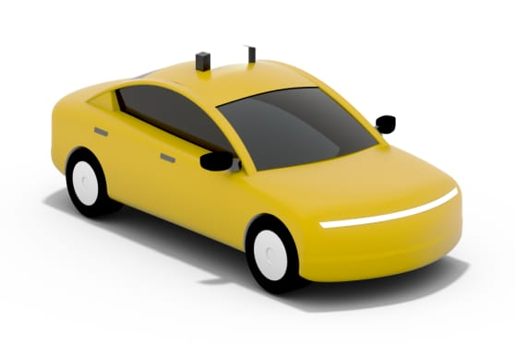
ABOUT CAB BOOKING SYSTEM
Let’s starts with the set of slides to know
more about the Project…………..

Slide 9
ABOUT THE PROJECT
Login and SignUp , search the cab and confirm the booking.
Coded in python and comes with a graphical user interface to facilitate the users.
Include 6 different module SignIn , SignUp , Forgot Password , add cab , Search Cab , Help box.
Includes SQl database Connectivity .

Slide 10
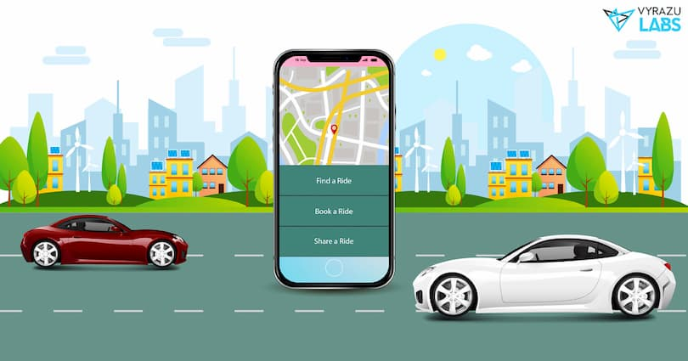
Let’s get a look towards the
project through some
of The snapshots of
it….

Slide 11
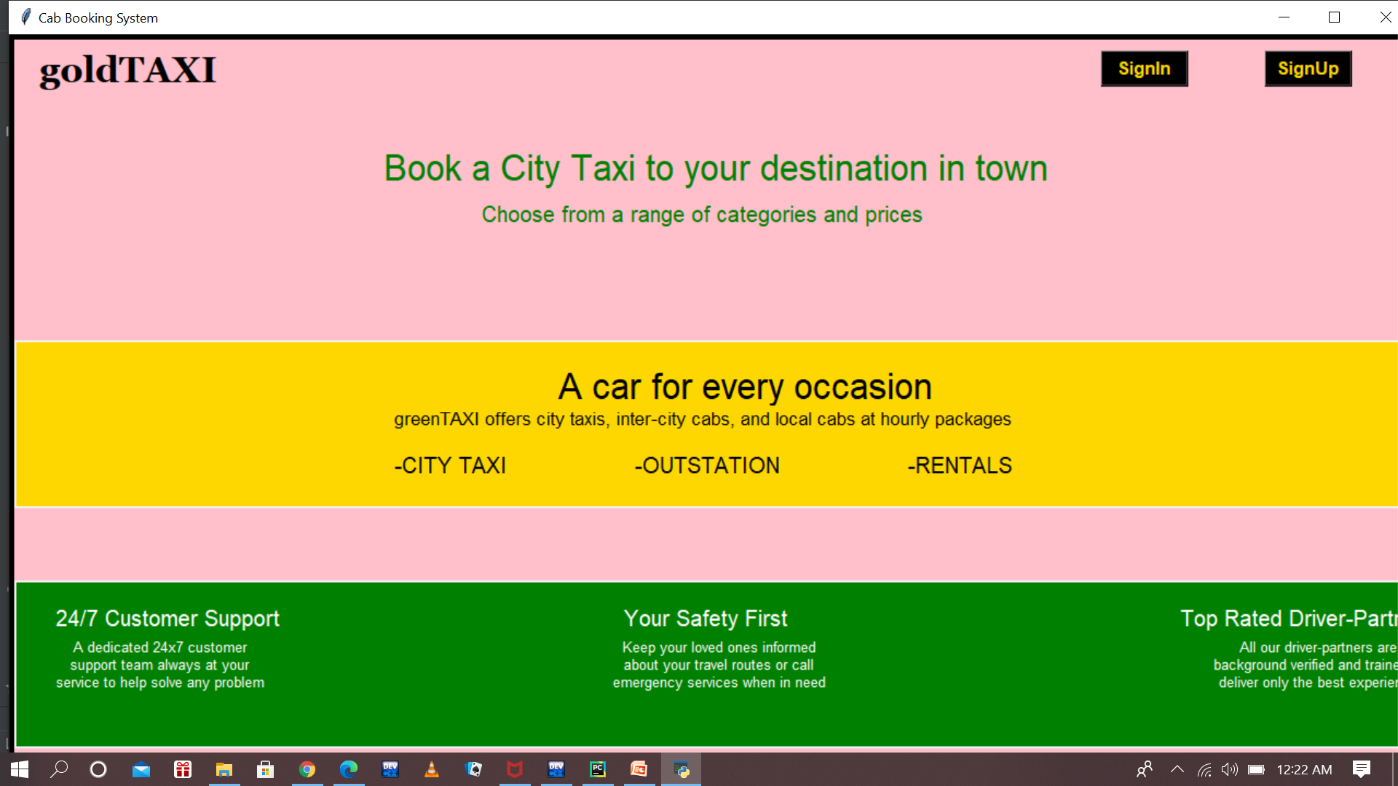
FIRST PAGE

Slide 12
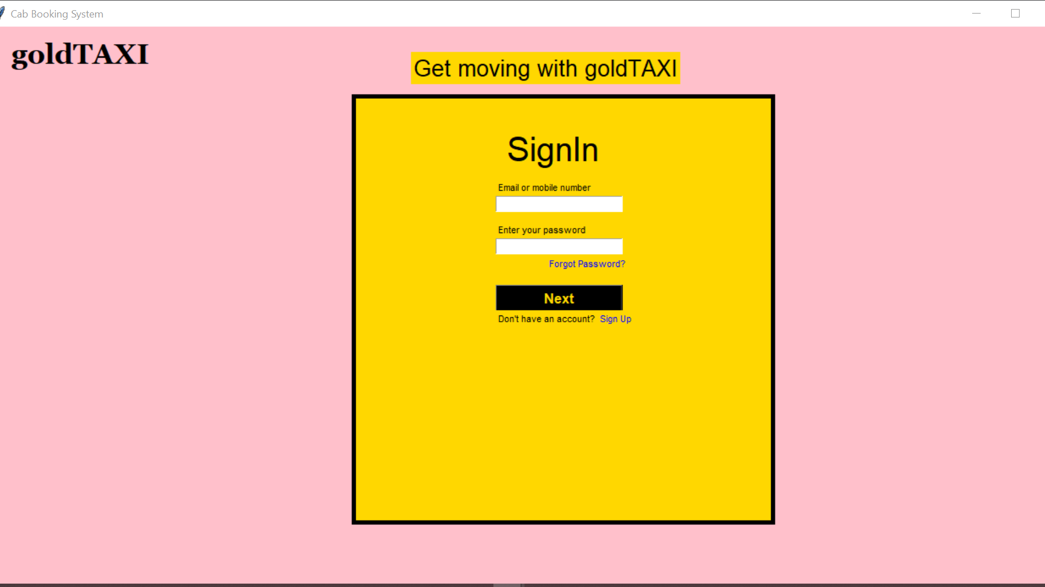

Slide 13
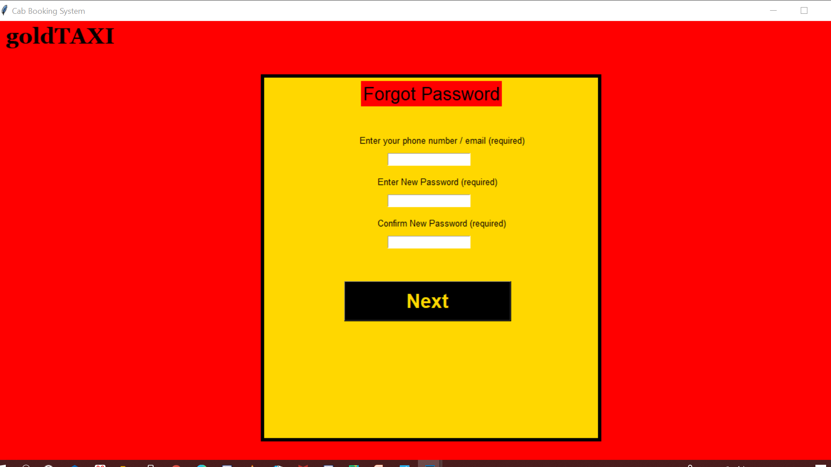

Slide 14
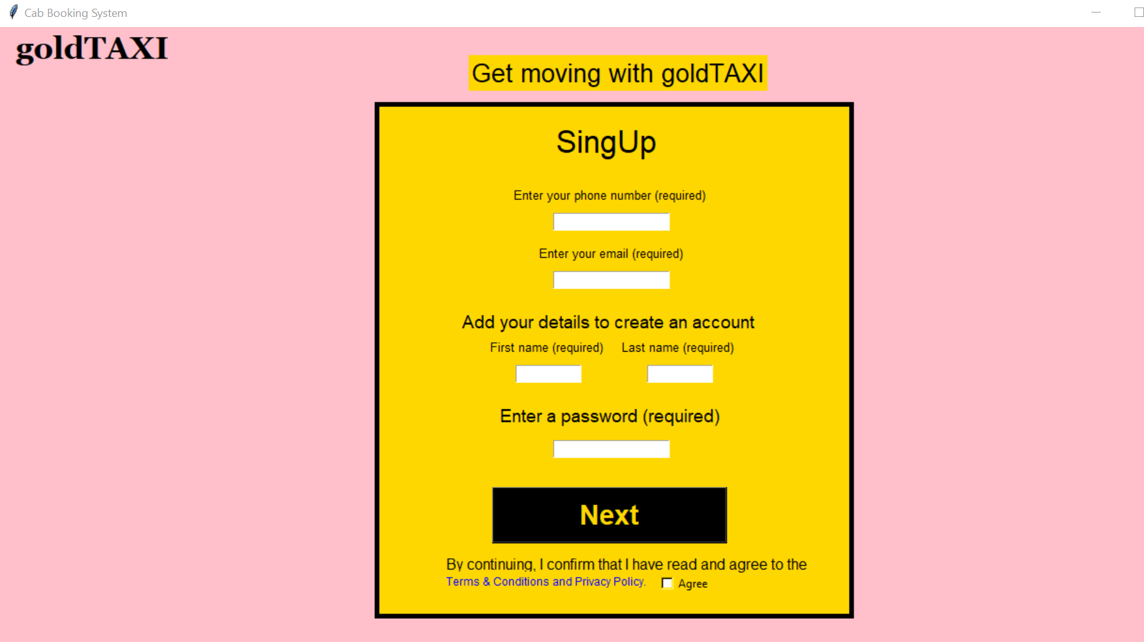

Slide 15


Slide 16
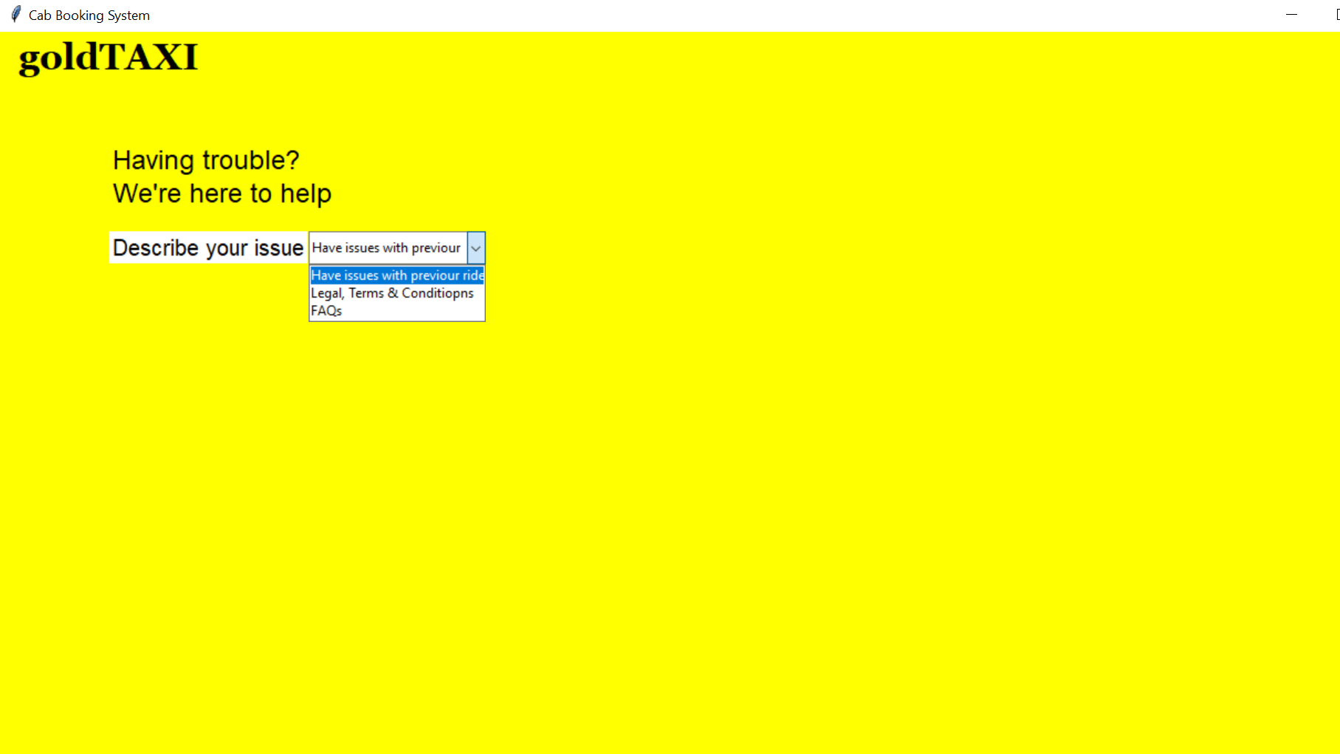

Slide 17
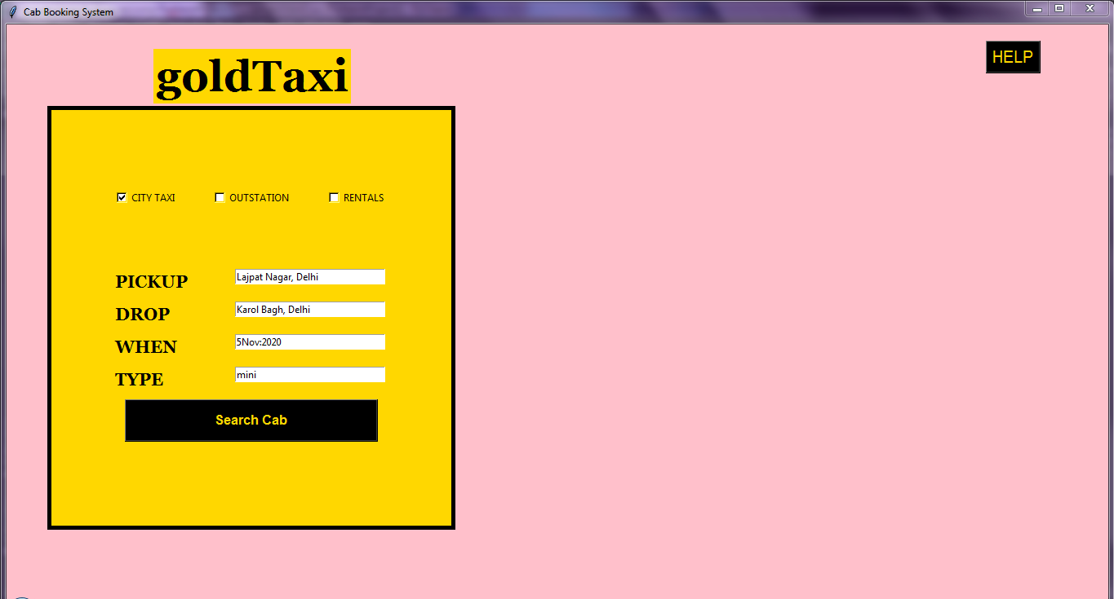

Slide 18
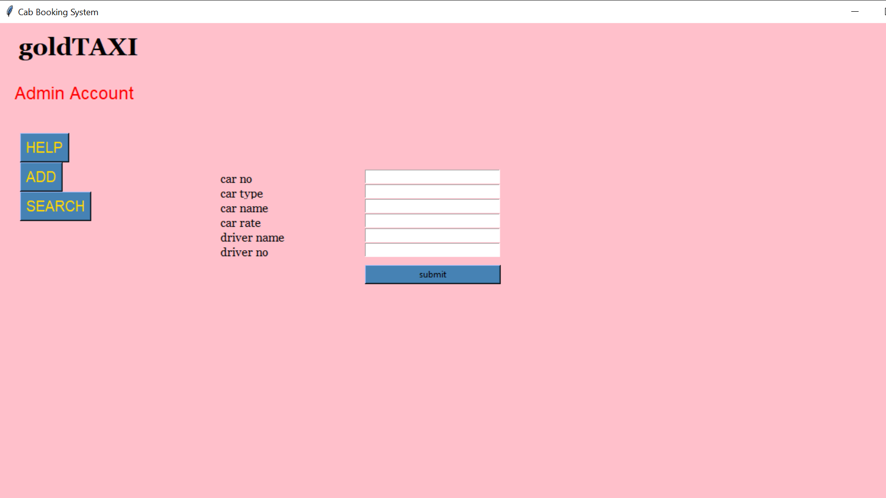

Slide 19
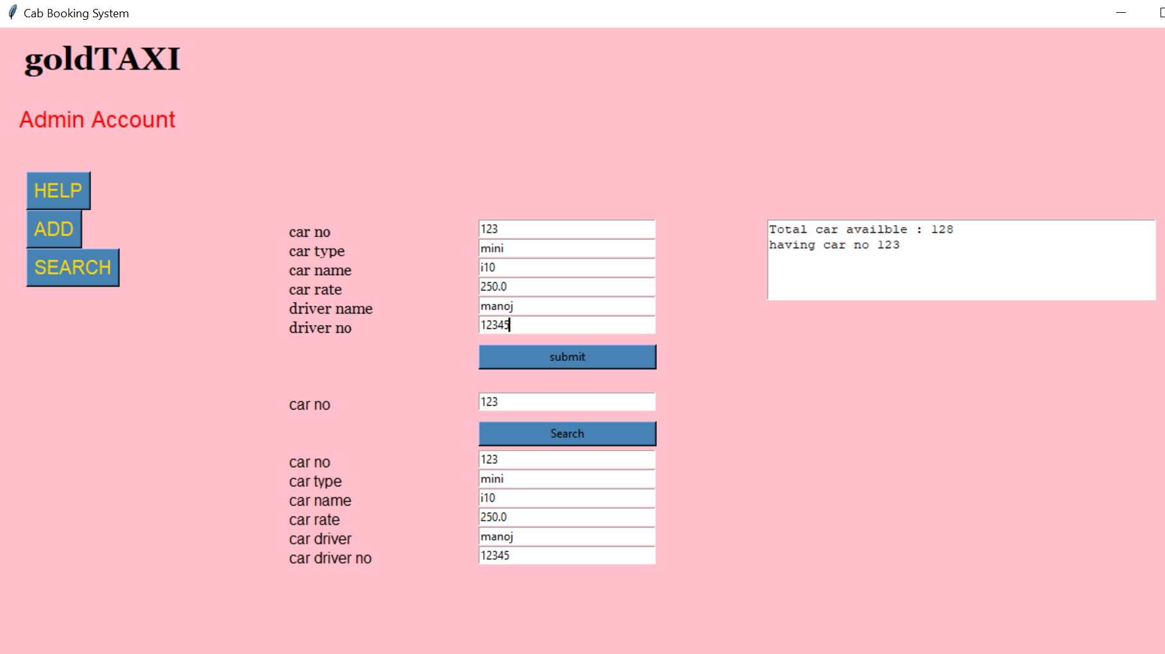

Slide 20
CONCLUSION AND RESULTS
The end product is obtained that includes all the mentioned modules discussed earlier.
Learnt to make GUI using Tkinter in python.
Learnt to implement database connectivity using sqlite3.
The project is capable of taking booking of cab and show the details field .by user.

Slide 21
BIBLIOGRAPHY
https://www.geeksforgeeks.org/sql-using-python/
https://www.w3schools.com/python/
https://stackoverflow.com/
https://tutorialspoint.com/
www.quore.com/
www.reddit.com/
www.google.co.in/
https://javatpoint.com/

Slide 22
.
THANKS!

